Slide 1
Concepts | Single Case Studies and Process Tracing
Doing Political Research, Week 6

Slide 2
Concepts
How should we understand concepts? Do you take the classical view or the prototype/family resemblance view?
What makes for a good concept?
Consider a concept that you have come across in your studies.
Is it useful?
Is it contested?
Has it been stretched?
Can it be sub-divided or aggregated with other concepts? Can you move up and down the ladder of abstraction?

Slide 3
Russell and Serban
What is the ‘Westminster model’?
Why do Russell and Serban criticise it as a concept?
Should we abandon the concept? Are there ways in which it could be useful?

Slide 4
Designing a Single Case Study Project
Choose a research question to investigate a political process or phenomenon and design a process tracing case study to answer it.
What is your case a case of? To what extent can you generalise from your case?
What is the process you are trying to trace? What are the important explanatory variables?
What evidence will you collect? How will you establish the causal process?

Slide 6
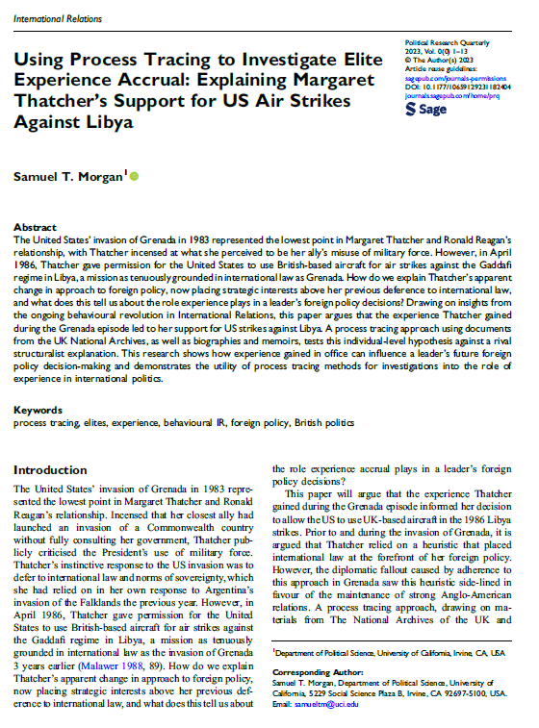
Morgan
What case does Morgan examine? What is this a case of?
How generalisable are the findings from this single case?
What evidence did Morgan use? How convincing is it?
How could the study have been improved? What other methods could have been used? Would a comparative case study have worked better?

